Slide 1
ADMISSIONS ONLINE APPLICATION SYSTEM
MEDIATION PRESENTATION 2017 for 2018 LEARNER INTAKE

Slide 2
BACKGROUND
The Admissions Online Application was conceptualised in 2009, but introduced in 2014 when both paper based and e – Admissions Applications were used
In 2016 the Admissions Online Application went live on 19 April – using Online Admissions Applications only
The Objectives of the Admissions Online Application remains:
Eradicating long queues at schools during the Application period
Creating a centralised database for Planning and Reporting purposes
Ensuring that learners are placed within the legislative prescripts

Slide 3
REVIEW OF THE ADMISSIONS ONLINE APPLICATION
In 2016, a stakeholder review of the System was conducted
Feedback received from:
Parents and SGB Associations
School Principals and School Administrators
IDSOs, Circuit Managers, Administrative Staff, Interns and Head Office was used to develop New Features for the Admissions Online Application for 2018
After the review, the new features were incorporated into the system including, but not limited to:
Application Process Only – No Registration
Interactive Landing Page with regular updates
Clear Identification of Boy Schools/Girl Schools/ Schools of Specialisation/ Technical Schools/Schools with Boarding facilities/Combined Schools/Junior primary Schools and senior Primary schools
Electronically signed off Waiting Lists

Slide 4
REVIEW OF THE ADMISSIONS ONLINE APPLICATION
To enhance the effectiveness of the Admissions Online Application System the GDE is working in collaboration with SITA, e-Government and the Department of Home Affairs
The collaboration has ensured the following:
Functional Test and Risk Assessment
On site Test Environment
Process to verify Identity Numbers of all South African Citizens

Slide 5
Admissions Advocacy
The HOD has pronounced the Opening of the Admissions Application Period
Admissions Advocacy will be significantly enhanced and accelerated during each period of Admissions (Application and Placement)
Each school needs to conduct additional localised advocacy
Principals are urged to raise awareness to parents with Grade 7 learners about the need to apply online
Grade R sites must communicate with parents the Application Period

Slide 6
LEGISLATIVE FRAMEWORK
In terms of Section 9 of NEPA the Admission Policy of a Public School and the administration of admissions by an Education Department must not unfairly discriminate in any way against an applicant for admission.
Section 34 of NEPA provides the preference order of admissions as:
(i) Learners whose parents live in the feeder area in their own or employers’ domicile
(ii) Learners whose parents work address is in the feeder area
The Provincial Admissions Regulations, General Notice No. 4138 of 2001 provides that the learner whose parents live or work in the area must apply to a school closest to the address or apply to a school where the learner has a sibling

Slide 7
FRONT – END (used by APPLICANTS)
APPLICATION PROCESS
Parents access the web address: http://www.gdeadmissions.gov.za or (www.gautengadmissions.gov.za) to be on the “Welcome to Admissions Online Application for 2018” page

Slide 8
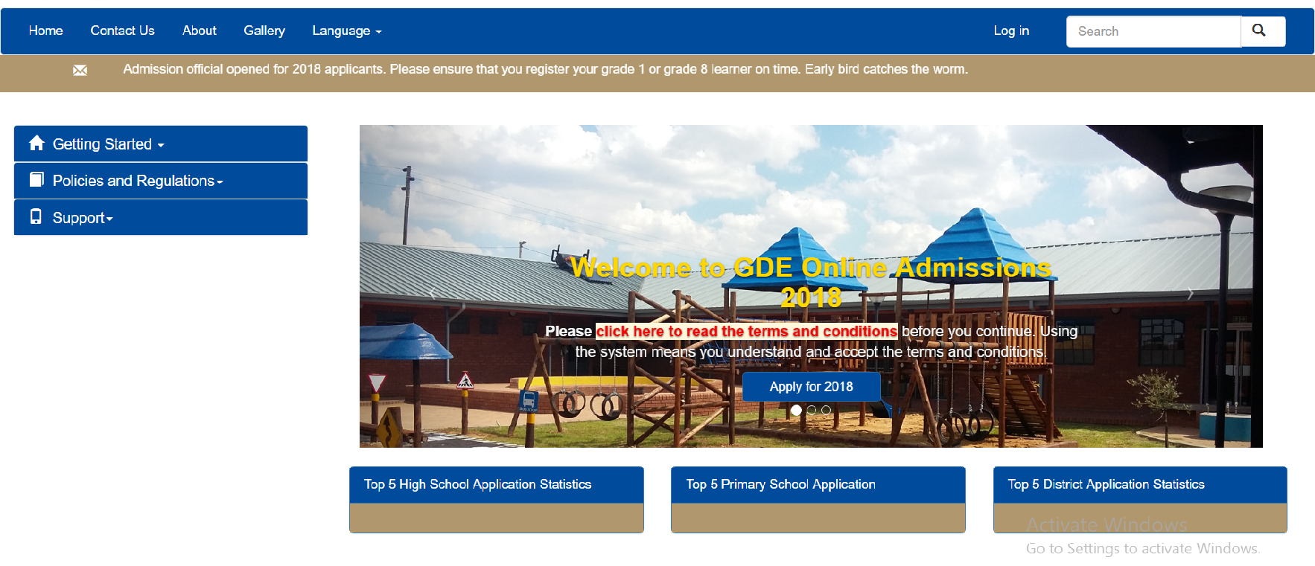
2018 ONLINE ADMISSIONS: A STEP-BY-STEP GUIDE
06 April 2017

Slide 9
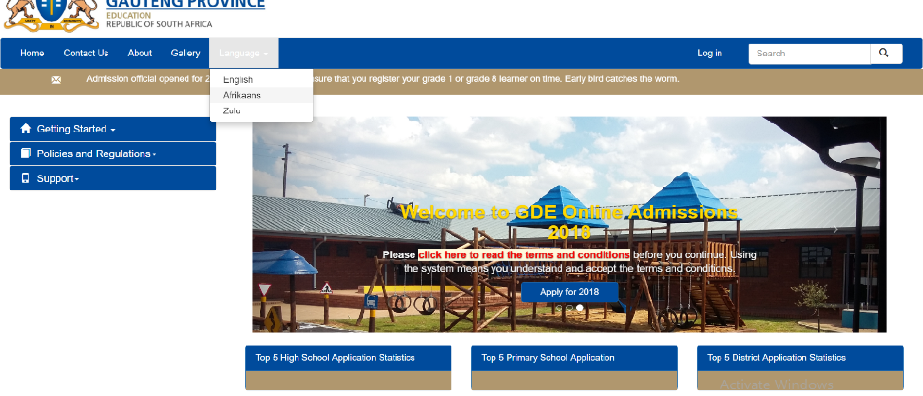
Introduction – HOME PAGE
You are advised to read all the information on the welcome page and click on the hyperlink for the Terms and Conditions.
Apply using one of the languages provided
Click on apply for 2018 to begin the application process

Slide 10
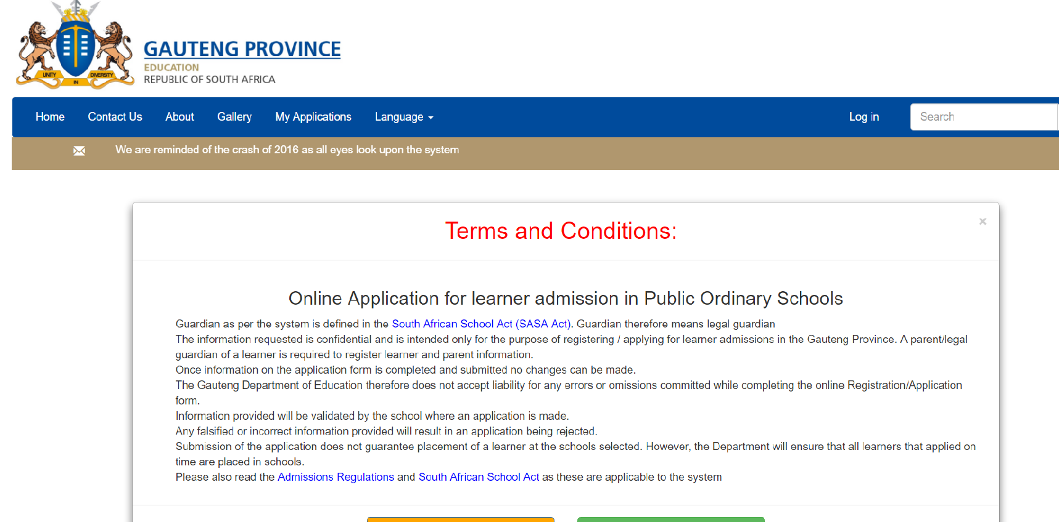
TERMS AND CONDITIONS
Please take the time to read and understand the Terms and Conditions, once you are done, click on continue to apply

Slide 11
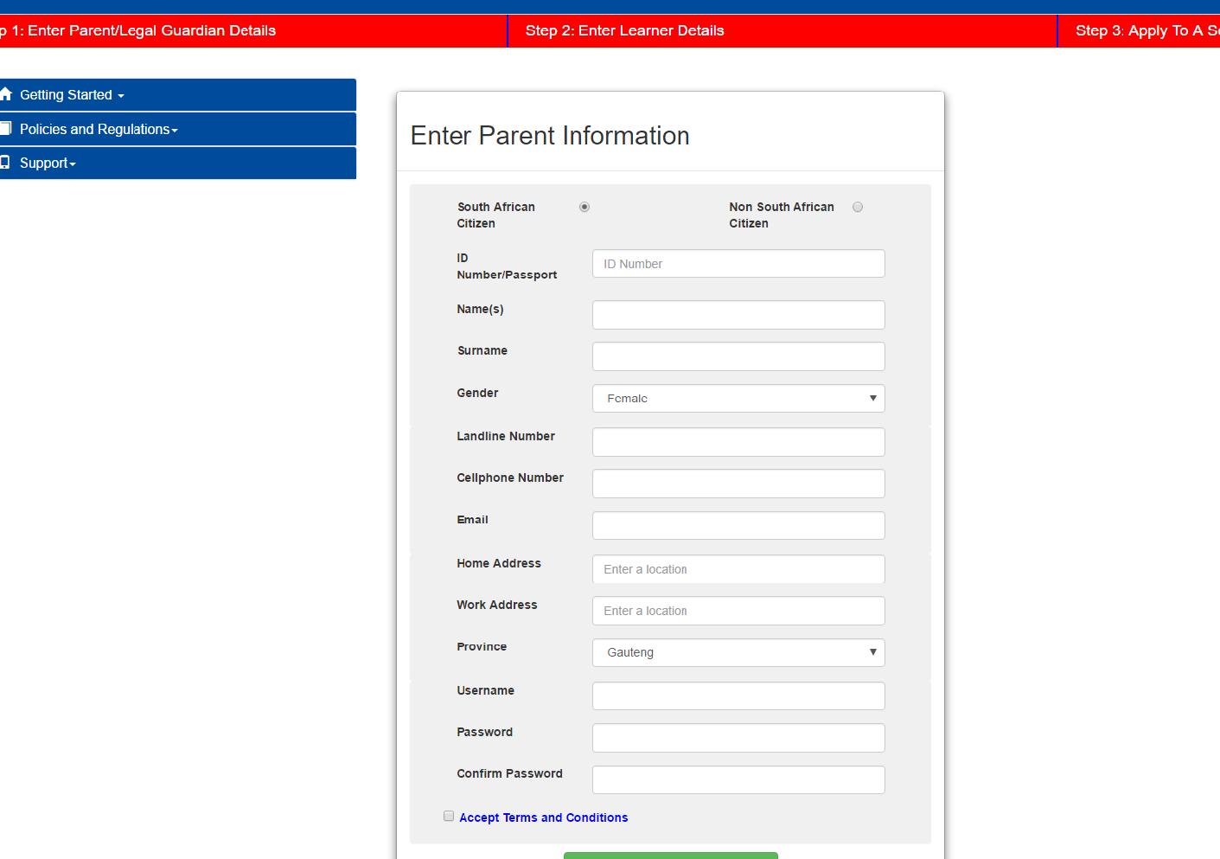
STEP 1 – ENTER PARENT DETAILS
There are three steps to complete when applying for admissions 2018. The step bar will turn green to indicate the completion of that step, orange when busy with it and remain red when incomplete.
You are now required to enter parent/ guardian information
Specify whether you are South African or non South African Citizen by clicking the relevant selection
Step 3 will remain red to allow parents to process multiple applications.
The required fields are the ID/passport number, names and surname, gender, cellphone, and home address. The parent or guardian’s cellphone number will be used to communicate the progress of the application and for regular updates.
Create a username and password, which you will easily remember. The password must have 8 characters which for example, includes amongst others, letters, numbers and a special character. Example,P@ss2018.
Check the box to accept the Terms and Conditions. Submit parent/guardian information.
Look out for an SMS which will be sent to you indicating the login username and password.

Slide 12
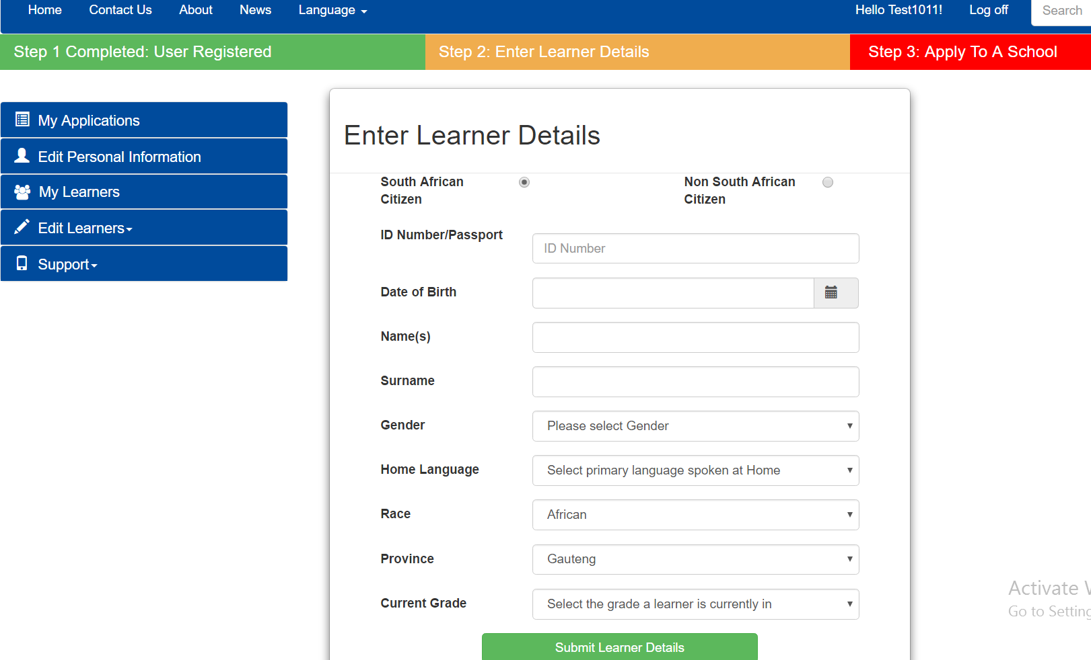
Step 2 – Enter Learner Information
NB! The information you submit in each step, will be saved should you be logged off or unable to continue; you will be able to begin where you left off.
Enter the ID or passport number of the learner
The date of birth will automatically populate based on the correct ID number provided.
Enter the learner’s names and surname
Select the gender and the primary language spoken at home
Select the race, current Grade (Pre- Grade 1(Grade R) or Grade7) and school of the learner.

Slide 13
ENTER LEARNER DETAILS
If you are applying for Grade 8, it is mandatory to enter the current school of the learner.
Ensure that the information supplied is correct. Click on “Submit Learner Details’.

Slide 14
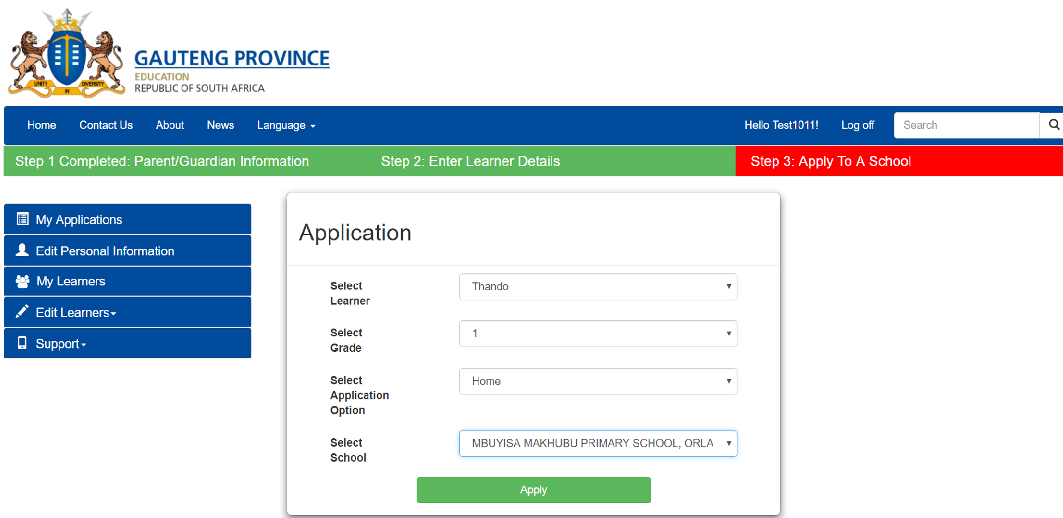
STEP 3 – SELECTING A SCHOOL
The colour bar has changed to green, indicating the completion of step two.
We have completed the personal information section and now move to the school selection process.
A notification will appear advising to first use the home or work address when applying to ensure that all applications have a Waiting List A number. Sibling to come next. Click okay.
Select the Learner, select the Grade
Select the Application Option (either home or work address)
Select the School
Click on Apply

Slide 15
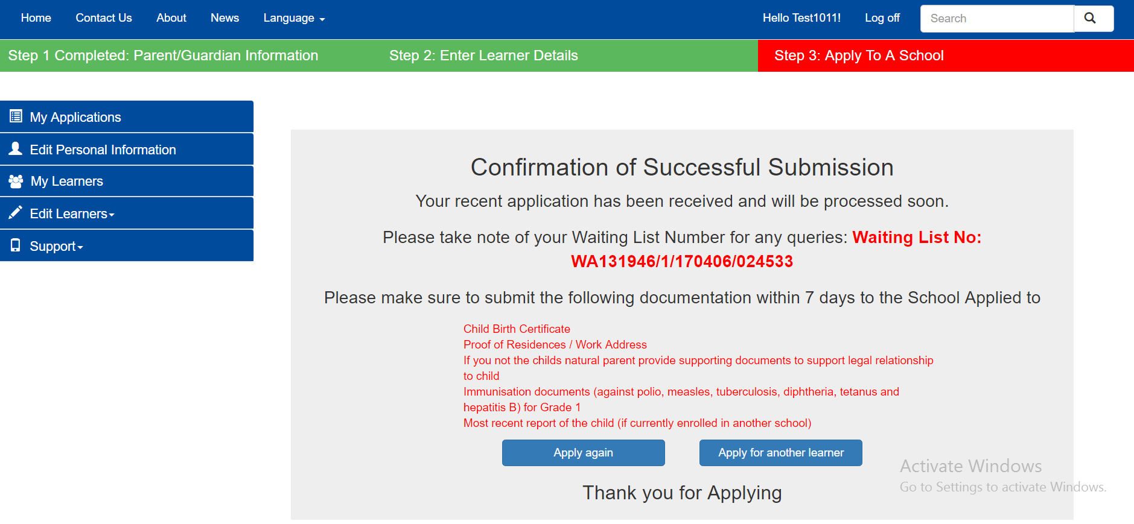
STEP 3 – SELECTING A SCHOOL
You have successfully applied for a school. Take note of your Waiting List Number, which will be sent to you via sms as well as the documents that need to be submitted to the school as soon as possible
Submit all the required documents to the school where you have applied
That concludes the admissions 2018 step-by-step guide. Thank you for applying! Should you require further information, please call us on 011 355 0000 or email to gdeinfo@gauteng.gov.za or visit your nearest admission centres, which are listed on the website.

Slide 16
MY APPLICATIONS
Select My Applications to view the applications you have made
To edit your information, click on Edit Personal Information
Select My Learners to view the learners/children saved under your profile

Slide 17
ADD SIBLING
Sibling means one of two or more children having one or both parents in common
A male sibling is a brother and female sibling is a sister
Note a sibling must be residing in the same household and meeting the admission criteria

Slide 18
REGISTER SIBLING
To apply for a learner with a sibling at a school, select sibling option on the select Application Option . Register the sibling learner’s details by completing all the fields on the form and submit

Slide 19
APPLY FOR EXISTING LEARNER
Only records of learners that information has been provided for will appear

Slide 20
DELETED APPLICATION

Slide 21
(UNREGISTERED) ADDRESS
Home and Work address are compulsory

Slide 22
WAITING LIST B
Parents must take note of the Waiting List Number.
WA – Parent qualifies in terms of the Regulations
WB – Parent does not qualify and needs to apply to a school where the Waiting List will be WA
WAB – the system cannot locate the coordinates of the address and the school will verify when parents submit documents
NB! If the Waiting List is WB or WAB, the possibility is that the learner will not get a space at the school where the parent applied. It is therefore recommended that the parent applies where the Waiting List will be WA

Slide 23
QUESTIONS – FRONT END

Slide 24
SCHOOL BACKEND MEDIATION

Slide 25
SCHOOL VIEW
Administrator will be in a position to view all applications and use APPLICATIONS STATUS filter to extract specific information

Slide 26
LIST OF APPLICATIONS
View of Application Reports – Pending Applications

Slide 27
TRACK APPLICATION
Schools will be able to Track an application by using a learner’s ID number and click on the button VERIFY to update Document Status

Slide 28
DOCUMENTS VERIFICATION
All submitted documents will be indicated with a tick and status will be updated as and when documents are submitted. School needs to provide Parent with a receipt as evidence of documents submitted

Slide 29
WAITING LIST – STEP 1
Preparation of Waiting list by indicating all successful and unsuccessful applications with comments
All applications will move to Waiting List STEP 2 after judgement according to the admissions criteria in Admissions Regulations

Slide 30
WAITING LIST – STEP 2
Principal verifies the decisions /outcome of each application
School will indicate successful and unsuccessful only up to the school’s capacity to admit learners

Slide 31
WAITING LIST –STEP 2
Principal approves Waiting List and submit to District Director for approval by clicking Submit. IDSOs and Circuit Managers will peruse the Schools successful and unsuccessful applications and approve only if school has acted in compliance with Legislative Prescripts. Process to occur in consultation with Principal. District Director to intervene in event of disagreements

Slide 32
PLACEMENT STEP1
The District Approved Waiting List will be located under Placement Step 1 for placement

Slide 33
APPROVED WAITING LIST
An accept button will be activated next to each successful application
Placement can be action one-by- one or by clicking accept all

Slide 34
QUESTIONS: BACK - END

Slide 35
THANK YOU
THANK YOU

